Slide 1
Functions
Defining a function
Counts the number of occurrences
def count(data, target) – function signature
body of function expressed as an indented block
return statement

Slide 2
Information passing
Parameters
Formal parameter
Actual parameter
prizes = count(grades, A )

Slide 3
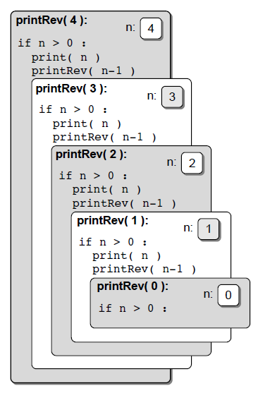
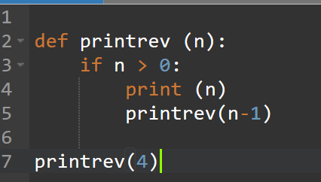
Recursive Function
Reverse print example
Print integer values from 1 to n in reverse order

Slide 4

The factorial Function
Recursive implementation
Mathematical example

Slide 5
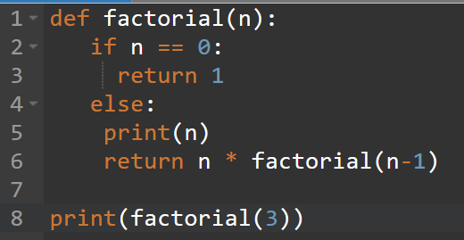
The factorial Function
Recursive implementation

Slide 6
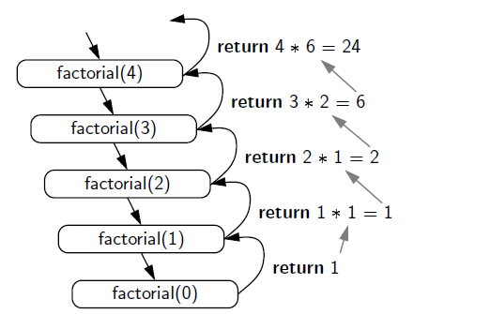
The factorial Function
Recursion trace

Slide 7
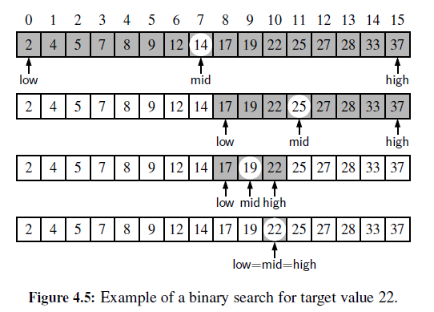
Binary Search
Binary Search with recursive function
All element must be sorted

Slide 8
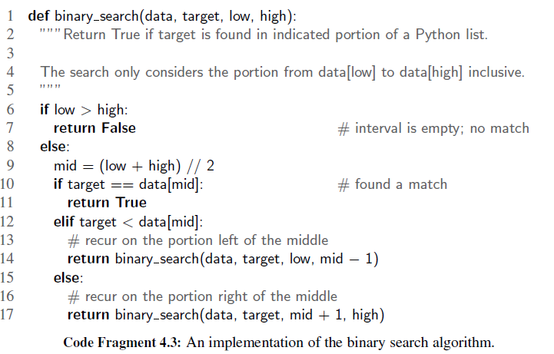
Binary Search function
Python implementation

Slide 9

What is Object Oriented programming ?
An object is like a block box.
The internal details are hidden.
Identifying objects and assigning responsibility to these objects.
Objects communicate to other objects by sending messages.
Messages are received by the methods of an object.
Marc Conrad University of Luton Lecture 1

Slide 10
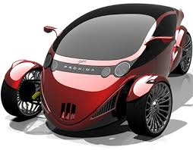



What is an object ?
Tangible Things as a car, printer, ...
Roles as employee, boss, ...
Incidents as flight, overflow, ...
Interactions as contract, sale, ...
Specifications as colour, shape, …
Marc Conrad University of Luton Lecture 1

Slide 11
What are objects ?
An object represent an individual, individual item, unit, or entity, either real or abstract, with a well-defined role in the problem domain.
or
An “object” is anything to which a concept applies.
Marc Conrad University of Luton Lecture 1

Slide 12
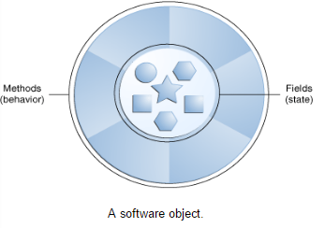
A software object
What possible states can this object be in?
What possible behavior can this object perform?
https://docs.oracle.com/javase/tutorial/java/concepts/object.html

Slide 13
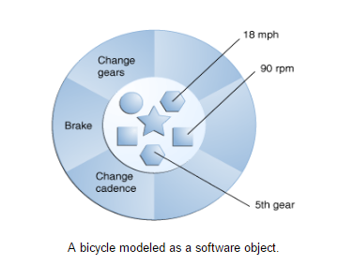
A software object
Store state in variables
Exposes its behavior through function
https://docs.oracle.com/javase/tutorial/java/concepts/object.html

Slide 14

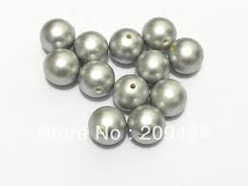


The two parts of an object
Object = Data(Variable) + Operaton (Function)
or to say the same differently:
An object has the responsibility to know and the responsibility to do.
= +

Slide 15
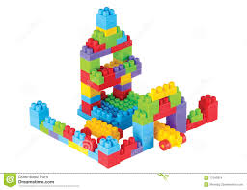
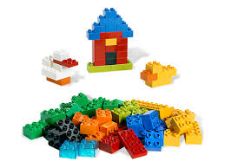
Why do we care about objects?
Modularity – large software projects can be split up in smaller pieces.
Reuseability – Programs can be assembled from pre-written software components.
Extensibility – New software components can be written or developed from existing ones.
Marc Conrad University of Luton Lecture 1

Slide 16
Basic Terminology
Abstraction is the representation of the essential features of an object. These are ‘encapsulated’ into an abstract data type.
Encapsulation is the practice of including in an object everything it needs hidden from other objects. The internal state is usually not accessible by other objects
Marc Conrad University of Luton Lecture 1

Slide 17
Object-Oriented Programming
Object-Oriented Design Goals
Robustness - a program produces the right output for all the anticipated inputs in the program’s application.
Adaptability - ability of software to run with minimal change on different hardware and operating system platforms.
Reusability – same code should be usable as a component of different systems in various applications

Slide 18
Object-Oriented Programming
Object-Oriented Design Goals
Modularity - Modularity refers to an organizing principle in which different components of a software system are divided into separate functional units
Abstraction - describing the parts of a system involves naming them and explaining their functionality
Encapsulation – Different components of a software system should not reveal the internal details of their respective implementations.

Slide 19
Object-Oriented Programming
Class Definition
A class serves as the primary means for abstraction in object-oriented programming.
Every piece of data is represented as an instance of some class.
self identifier
The self identifier plays a key role.
Syntactically, self identifies the instance upon which a method is invoked.

Slide 20
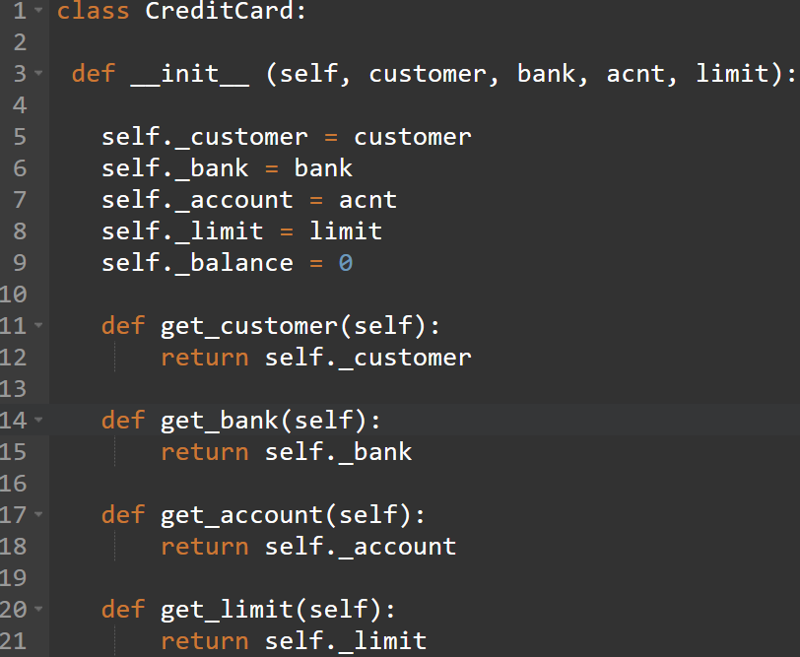
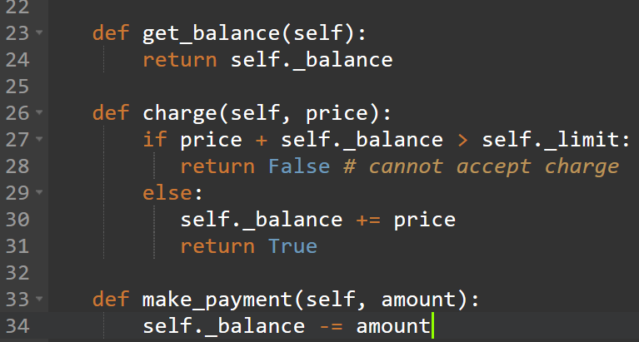
CreditCard class Example
class CreditCard:

Slide 21
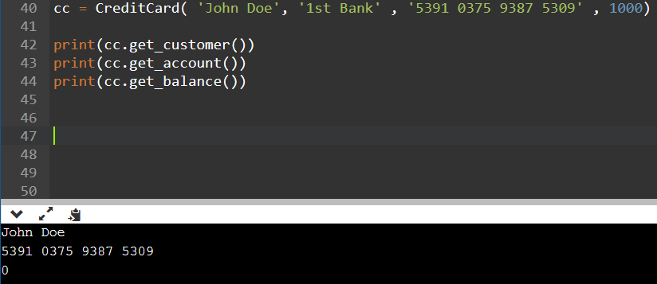
CreditCard Example
Constructor
primary responsibility is to establish the state of
a newly created credit card object with appropriate instance variables.

